Slide 1
Electronics II
EEET-222
Lab #2
Cascaded Amplifiers
RCC-13

Slide 2
Learning Objective
Lab equipment skills.
  Scope measurements.
  Function generator setup.
Circuit building and troubleshoot.
Introduction to operational amplifier circuits.
RCC-13

Slide 3
Pre-lab
  Please read the lab.
  Read the first two pages of “AN1325_ Choosing and Using Bypass Capacitors” by intersel.
RCC-17

Slide 4
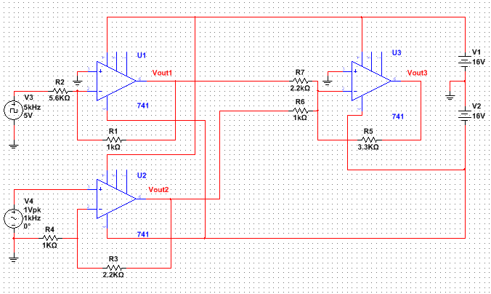
Circuits
Circuit #1
RCC-13

Slide 5
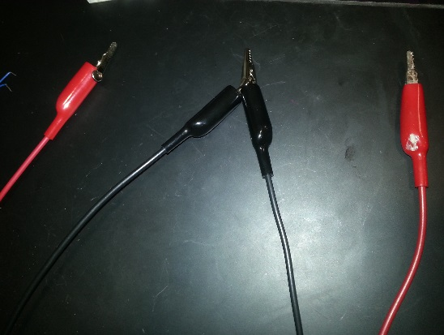
Procedure
Using your breadboard and parts from lab, build circuit #1 (use any three 741s), without connecting the ac function generator (v3 and v4) and without connecting the DC power supply (v1 and v2) to your circuit.
Generate the DC voltage needed for your circuit following these steps.
  Turn on the DC power supply and adjust two outputs to 16V.
  Connect wires to the power supply in such a way that you have three wires or groups of wires to connect to your circuit. Figure 1 shows a single wire for +16V, two wires for ground and one wire for -16V.
  Use the digital multi-meter to verify the voltage between +16V and ground is 16V. Verify that the power supply output current is zero.
  Use the digital multi-meter to verify the voltage between -16V and ground is -16V. Verify that the power supply output current is zero.
Figure #1
RCC-13

Slide 6
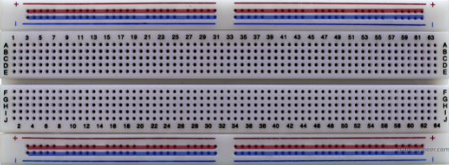
Procedure
Connect the DC voltage v1 (+16) to one of the red busses in figure 2, v2 (-16) to the red buss on the other side. Ground should be connected to BOTH blue busses. If your breadboard buss traces are broken in half like figure 2, use jumper wires to make them run continuously end to end.
Use the digital multi-meter to verify the voltage between pin 7 and ground is 16V for U1, U2 and U3.
Use the digital multi-meter to verify the voltage between pin 4 and ground is -16V for U1, U2 and U3.
Add a 0.1μF capacitor from 16V (red, plus or minus) to ground (blue) on each side of the breadboard. Install a total of two capacitors. The capacitors are installed in parallel with the power, not in series.
Figure #2
  Best Practice Tip:
  To save time, always follow these steps and verify the DC voltage before and after connecting power to your circuit.
  Always add capacitors to each power rail to reduce noise and oscillations.
RCC-13

Slide 7
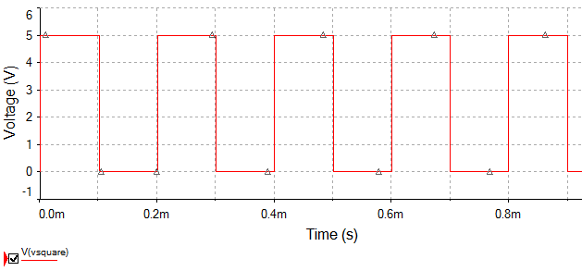
Procedure
Note: The function generator has two outputs that are called CH1 (channel 1) and CH2 (channel 2). The scope has two inputs also called CH1 and CH2. Make sure you read the instructions carefully so you know if you are changing the function generator or scope.
Turn on the oscilloscope, set both CH1 and CH2 to DC coupling (found in the vertical menu) and use a major gridline for the ground reference of each channel.
Now connect the function generator to your circuit using these steps
  Add 2.5V of offset to create v3 = 0-5V, 5KHz square wave, on the function generator’s channel 2. Verify the signal on the oscilloscope before and after connecting it to your circuit. Figure 3 shows a 0-5V, 5KHz square wave.
  Create v4 = 2V pk-pk, 1KHz sine wave, on the function generator’s channel 1. Verify the signal on the scope before and after connecting it to your circuit.
  Best Practice Tip: To save time, always verify the input voltages with the scope
  before and after connecting it to your circuit.
Figure #3
RCC-13

Slide 8
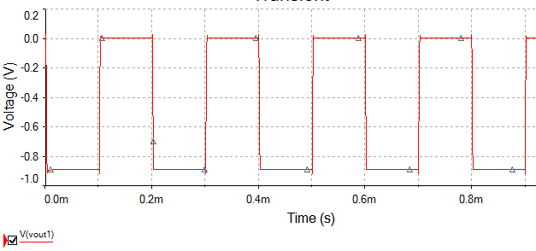
Procedure
Leave CH1 on the input to circuit 1. Using the scope, measure the peak to peak voltage vout1 (circuit 1) with CH2. Use what you know about an “inverting amplifier” to verify the output (calculate the gain). Your instructor will ask you to explain how you know the waveform is correct. A sample is shown in figure 4. If necessary, use he troubleshooting guide for vout1 on the next page.
Capture the scope waveform in a Word document. Write the signal name and the pin number where the waveform was measured below the screen capture.
Figure #4
RCC-13

Slide 9
Troubleshooting Guide for vout1.
  If you have a lab partner, let the person who did NOT build the circuit, check EVERY wire. Remember pin 1 is to the left of the notch or circle end of the IC and pins 4 and 5 are furthest away from pin 1. Pins are numbered in a counter-clockwise fashion.
  Disconnect vout1 and R7 as shown by the X in figure 5. Recheck vout1.
  If vout1 does not look right your problem is with the U1 circuit. Verify the DC power again and all connection in the U1 circuit.
  If vout1 was fixed by removing R7, your problem is with the U3 circuit. Verify DC power again and all connections in the U3 circuit.
Figure #5
RCC-13

Slide 10
Procedure
Move CH1 to the input for vout2. Using the scope CH2, measure the peak to peak voltage vout2 (circuit 1). Use what you know about a “non-inverting amplifier” to verify the output (calculate the gain). Your instructor will ask you to explain how you know the waveform is correct. If necessary, use he troubleshooting guide for vout2 on the next page.
Capture the scope waveform in a Word document. Document the pin number and waveform description below the screen capture.
Get a sign off.
Place CH1 on either input. Using the scope CH2, measure the peak to peak voltage vout3 (circuit 1). Use what you know about a “summing amplifier” to verify the output. Your instructor will ask you to explain how you know the waveform is correct.
Capture the scope waveform in a Word document. Document the pin number and waveform description below the screen capture.
Print the Word document. On each capture hand-write all calculations needed to verify the output.
Get a sign-off.
  Best Practice Tips:
  Always try to isolate a circuit when it is not working. Disconnect the circuit output when possible.
  Measure the input with CH1 and the output with CH2. It makes scope setup much easier.
RCC-13

Slide 11
Troubleshooting Guide for vout2.
  If you have a lab partner, let the person who did NOT build the circuit, check EVERY wire. Remember pin 1 is to the left of the notch or circle end of the IC and pins 4 and 5 are furthest away from pin 1. Pins are numbered in a counter-clockwise fashion.
  Disconnect vout2 and R6 as shown by the X in figure 6. Recheck vout2.
  If vout2 does not look right your problem is with the U2 circuit. Verify the DC power again and all connection in the U2 circuit.
  If vout2 was fixed by removing R6, your problem is with the U3 circuit. Verify DC power again and all connections in the U3 circuit.
Figure #6
RCC-13

Slide 12
Cascade Amplifiers
Lab 2 Sign-offs
Name _____________________________________ Correct vout1 and vout2
Correct vout3
Demonstrated that vout3 is correct
 |  | / /
Signature |  | Date
 |  | / /
Signature |  | Date
 |  | / /
Signature |  | Date
RCC-13

Slide 13
Report – Submit the following
Topic Page
Report Cover Sheet 1
Typed Summary (~100 words). 2
Vout1, vout2 and vout3 scope captures 3...
  with theory and lab calculations of voltage gain validating the Vout1 and Vout2 results.
Sign-off sheet last
RCC-13

